Slide 1



HOSPITALITY DASHBOARD
View in Power BI
Last data refresh:
8/4/2023 10:54:53 AM UTC
Downloaded at:
8/4/2023 11:09:44 AM UTC

Slide 2
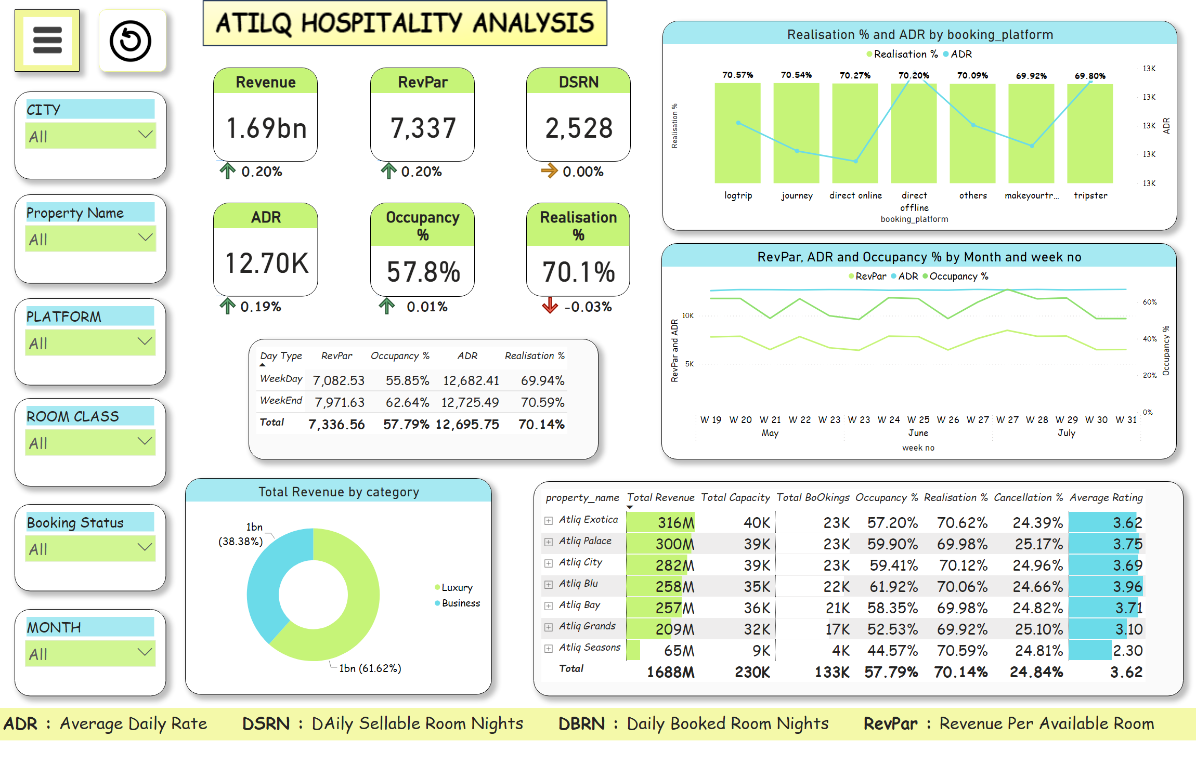
Overall Analysis
Notes:
donutChart
No alt text provided
lineClusteredColumnComboChart
No alt text provided
lineChart
No alt text provided
pivotTable
No alt text provided
ADR
No alt text provided
Occupancy %
No alt text provided
Revenue
No alt text provided
RevPar
No alt text provided
DSRN
No alt text provided
Realisation %
No alt text provided
pivotTable
No alt text provided
tableEx
No alt text provided
tableEx
No alt text provided
tableEx
No alt text provided
tableEx
No alt text provided
tableEx
No alt text provided
tableEx
No alt text provided
Slicer city
No alt text provided
Slicer property name
No alt text provided
Slicer platform
No alt text provided
Slicer room class
No alt text provided
Slicer BOOKING STATUS
No alt text provided
Slicer MONTH
No alt text provided
actionButton
No alt text provided
shape
No alt text provided
actionButton
No alt text provided
actionButton
No alt text provided
actionButton
No alt text provided
shape
No alt text provided
actionButton
No alt text provided
actionButton
No alt text provided
textbox
No alt text provided

Slide 3
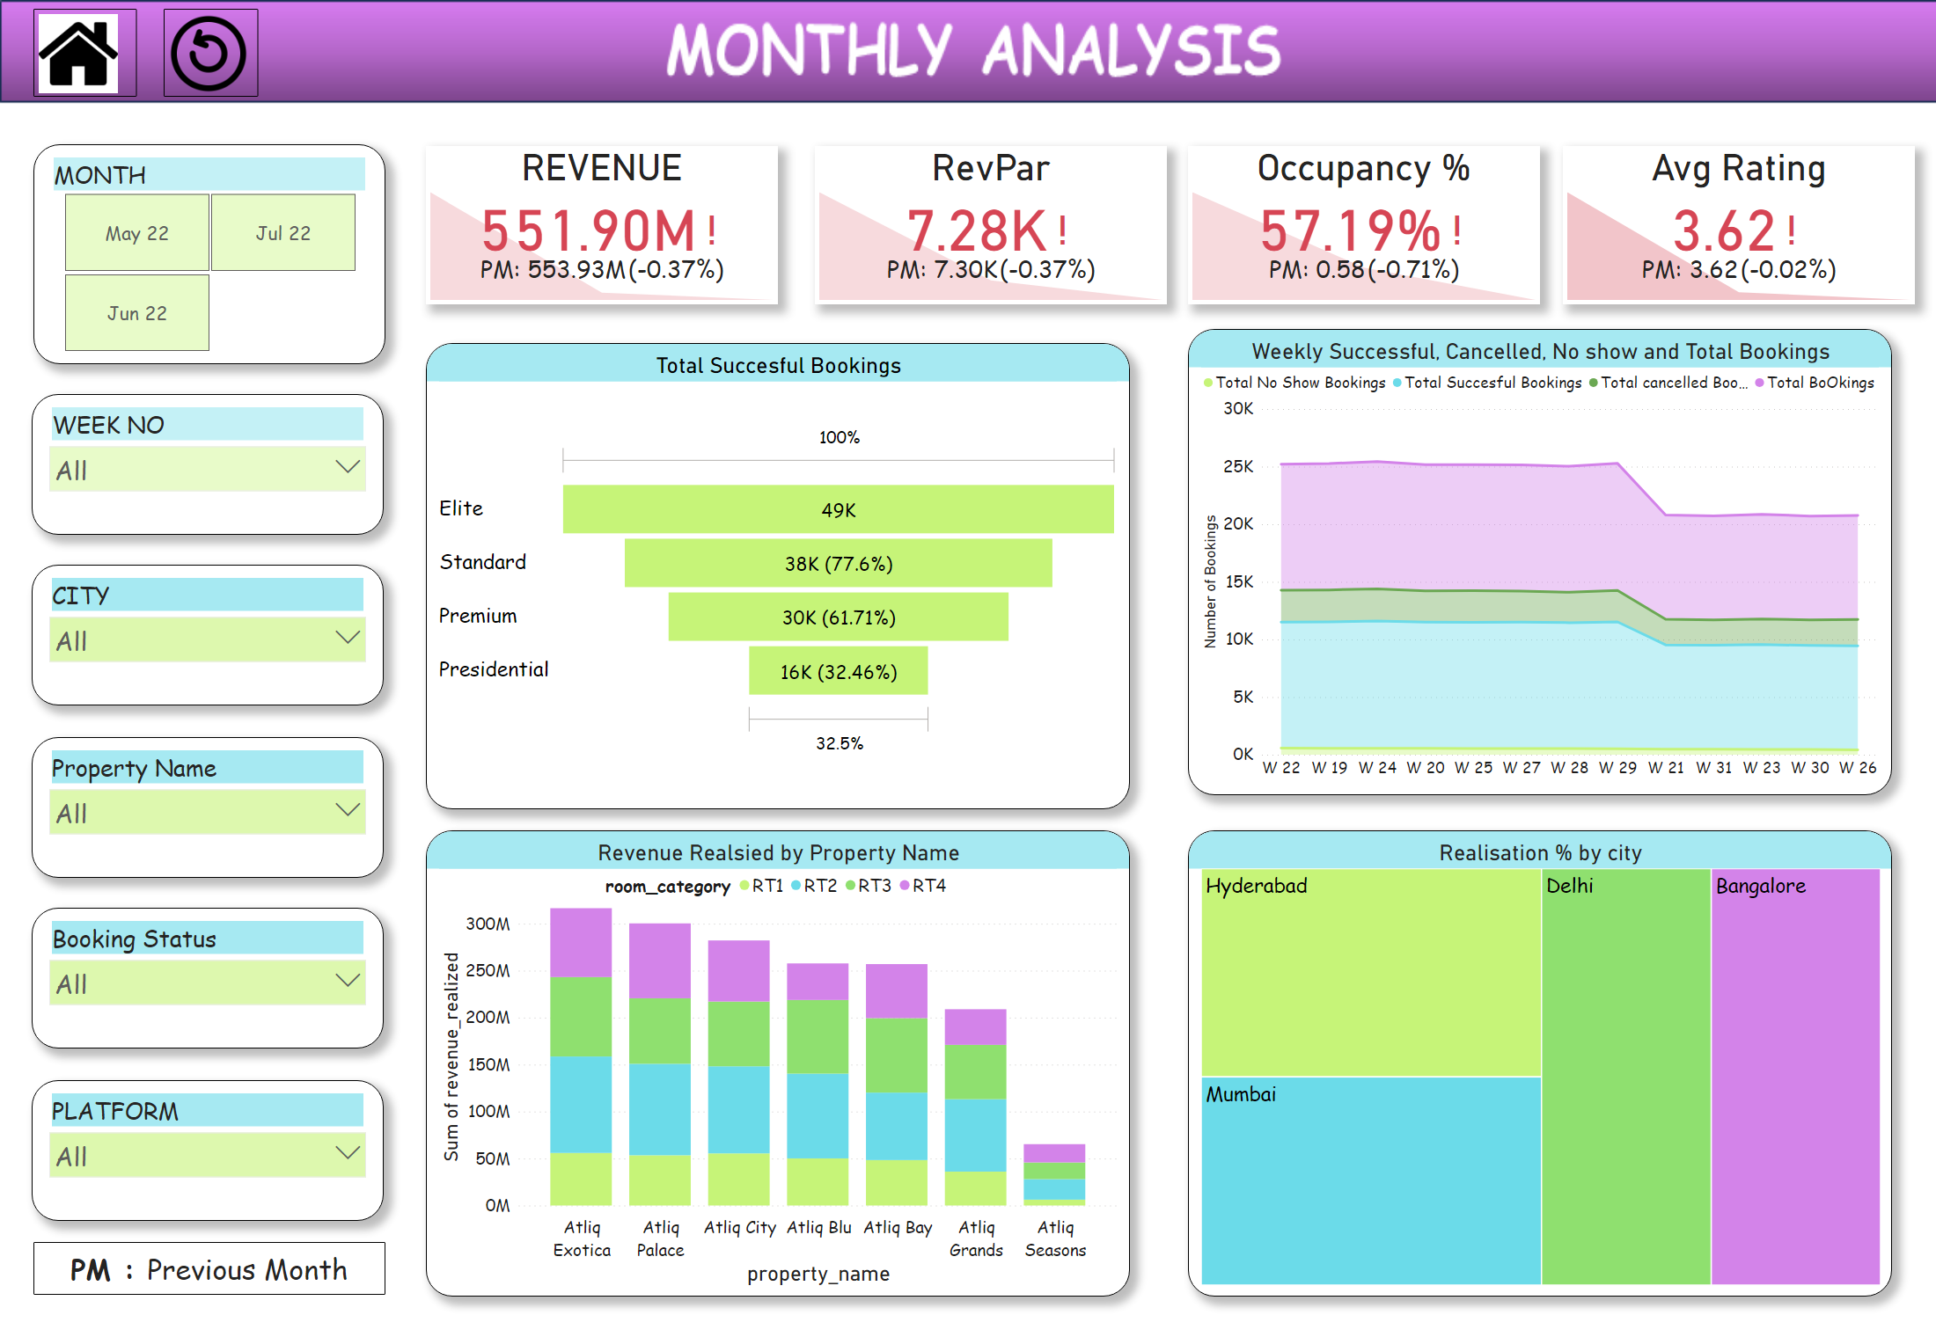
Monthly Analysis
Notes:
Avg Rating
No alt text provided
Occupancy %
No alt text provided
REVENUE
No alt text provided
Total Succesful Bookings
No alt text provided
Weekly Successful, Cancelled, No show and Total Bookings
No alt text provided
Revenue Realsied by Property Name
No alt text provided
treemap
No alt text provided
Slicer month
No alt text provided
Slicer week no
No alt text provided
Slicer city
No alt text provided
Slicer property name
No alt text provided
Slicer booking status
No alt text provided
Slicer platform
No alt text provided
RevPar
No alt text provided
actionButton
No alt text provided
actionButton
No alt text provided
textbox
No alt text provided

Slide 4
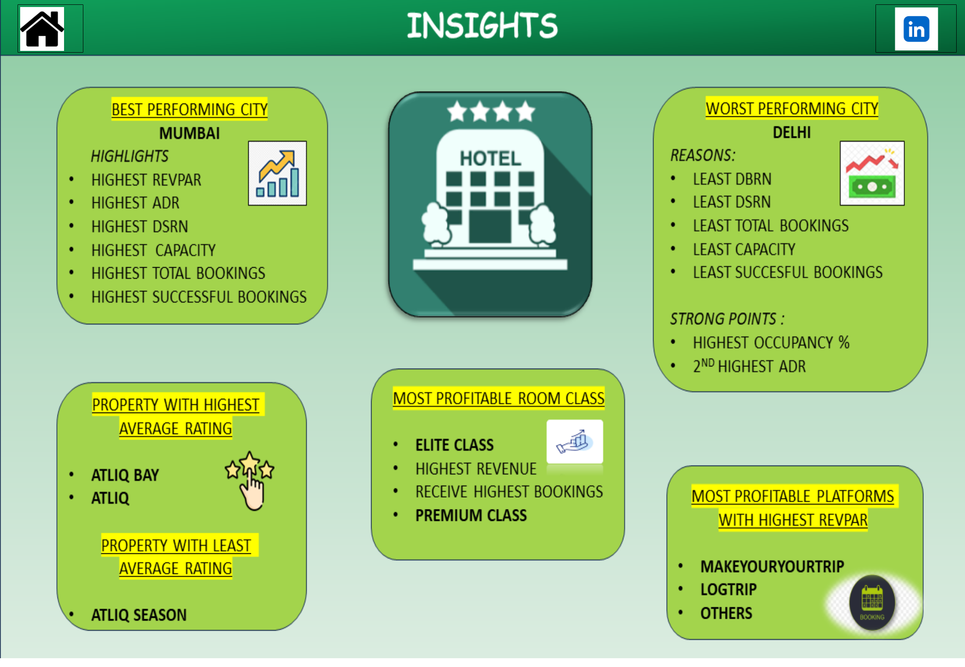
Insights
Notes:
actionButton
No alt text provided
image
No alt text provided

